Slide 1
Abstractive And Extractive Summarization of Tokopedia Product Review
RAFIF ADITIO
FTDSH8#003

Slide 2
Text Summarization
Final Project FTDSH8#003
INTRODUCTION
METHOD
PREPROCESS
MODEL BUILDING
MODEL INFERENCE
CONCLUSION
DISCUSSION
CONTENTS

Slide 3
INTRODUCTION
Text Summarization
Final Project FTDSH8#003

Slide 4

INTRODUCTION
Company
Customer
Text Summarization
Final Project FTDSH8#003

Slide 5
INTRODUCTION
Increasing amount of text data
Limitation of time
Text Summarization
“The act of expressing the most important facts or ideas about something or someone in a short and clear form, or a text in which these facts or ideas are expressed.”
-Cambridge Dictionary
Text Summarization
Final Project FTDSH8#003

Slide 6
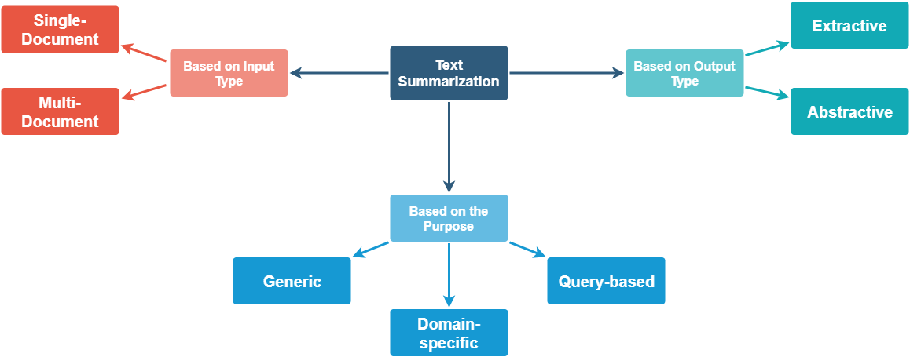
INTRODUCTION
Objective:
Get the most important information in short amount of time.
Text Summarization
Final Project FTDSH8#003

Slide 7
METHOD
Text Summarization
Final Project FTDSH8#003

Slide 8
METHOD
1. Dataset
Tokopedia Product Reviews (Kaggle).
2. Preprocess
Made sentiment based on ratings.
Removed unnecessary characters and words.
Word transformation to common form.
3. Summarization
Extractive Summ. using Pre-Trained BERTModel.
Abstractive Summ. using Pre-Trained Pegasus.
Extractive Summ. using Rule-based TextRank and Word Similarity.
Text Summarization
Final Project FTDSH8#003

Slide 9
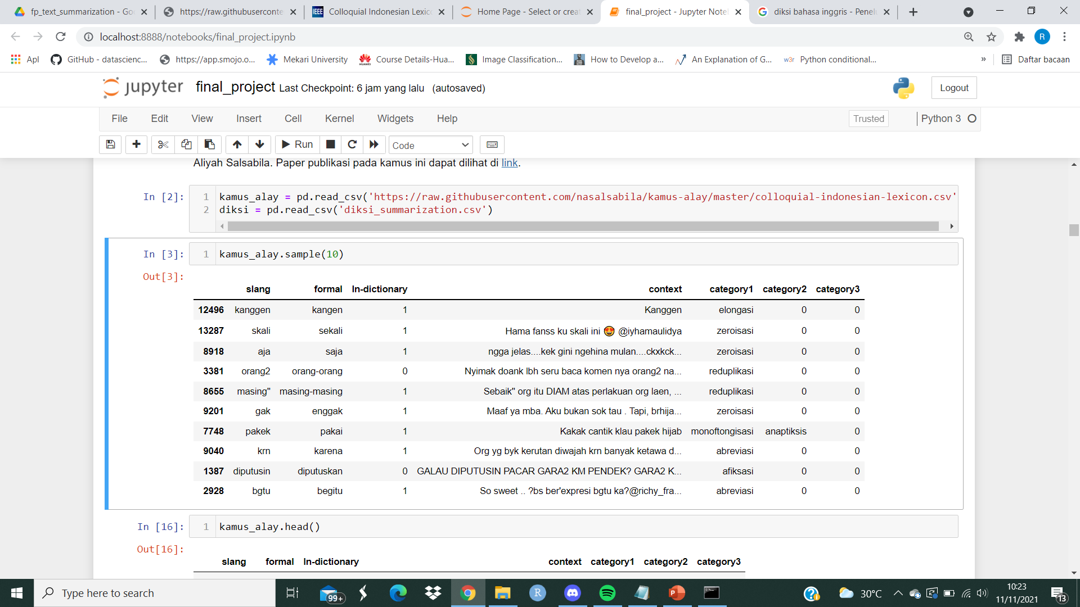
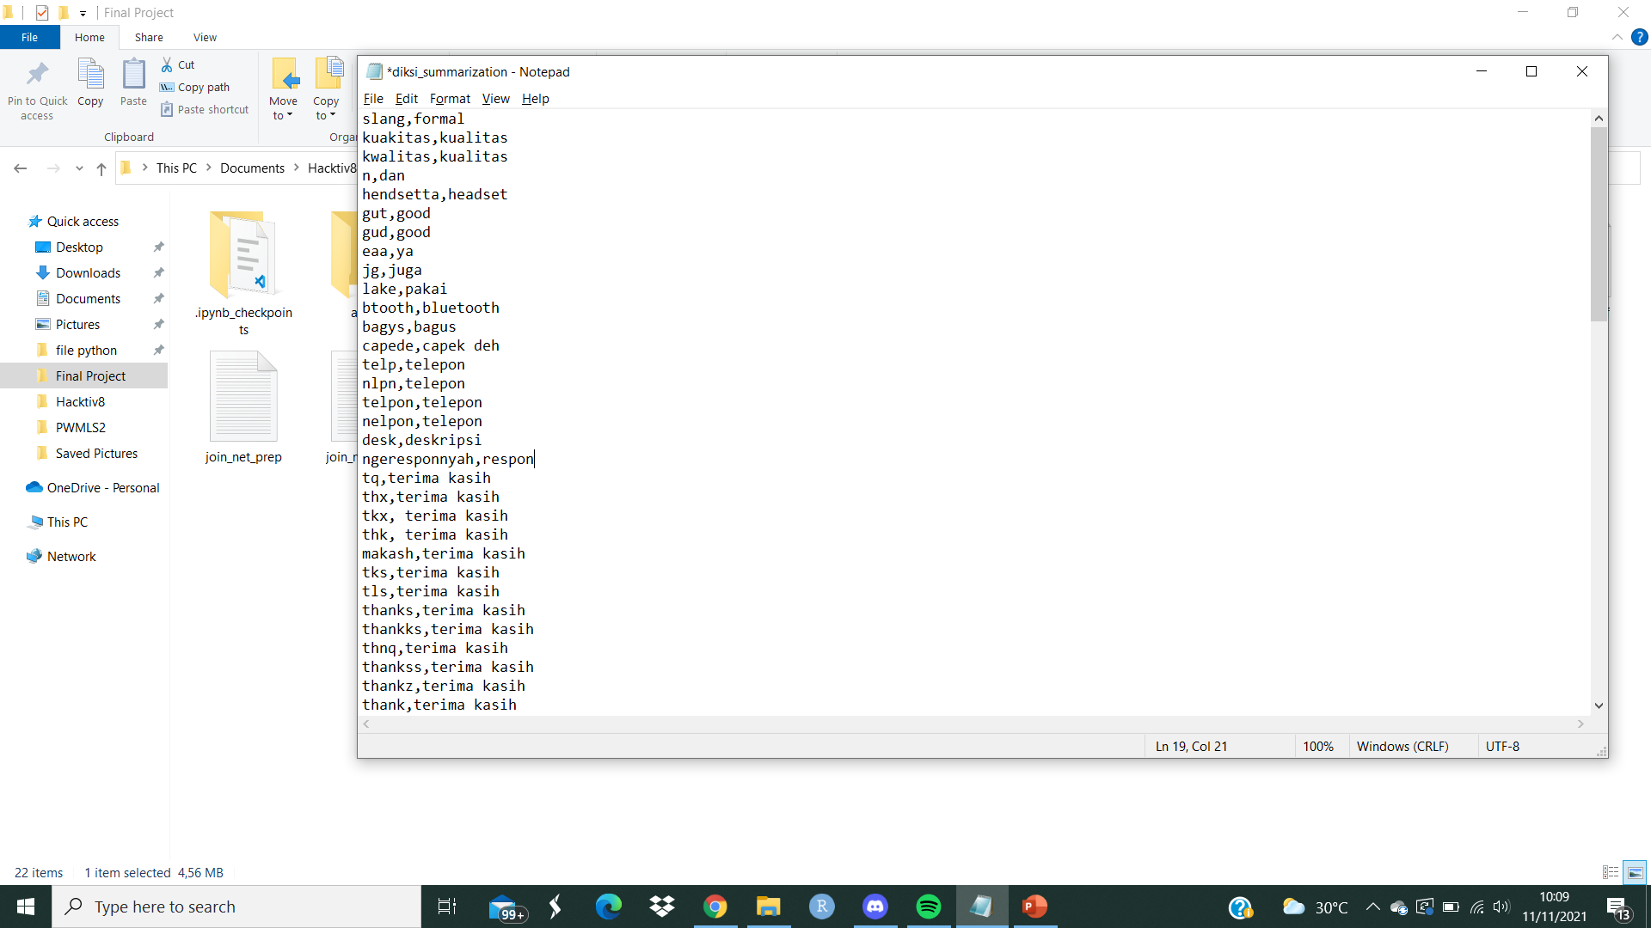
METHOD: Word Transformation
1. Colloquial Indonesian Lexicon
(N. A. Salsabila)
2. Specific Diction Transformer
Text Summarization
Final Project FTDSH8#003

Slide 10
PREPROCESS
Text Summarization
Final Project FTDSH8#003

Slide 11
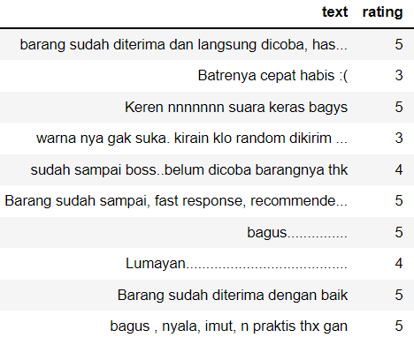

PREPROCESS
1. Input Data
2. Made Sentiment Based on Ratings
Rating
Sentiment
Label
Positive
2
Neutral
1
Negative
0
Text Summarization
Final Project FTDSH8#003

Slide 12
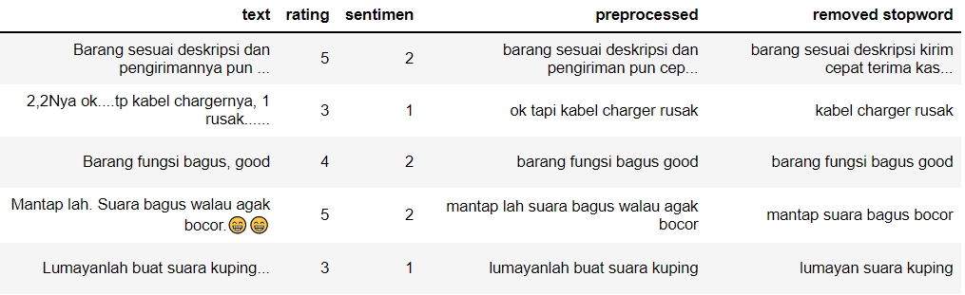
PREPROCESS
3. Removed unnecessary characters and
word transformation to its common form.
4. Removed Stopword and affix.
Text Summarization
Final Project FTDSH8#003

Slide 13
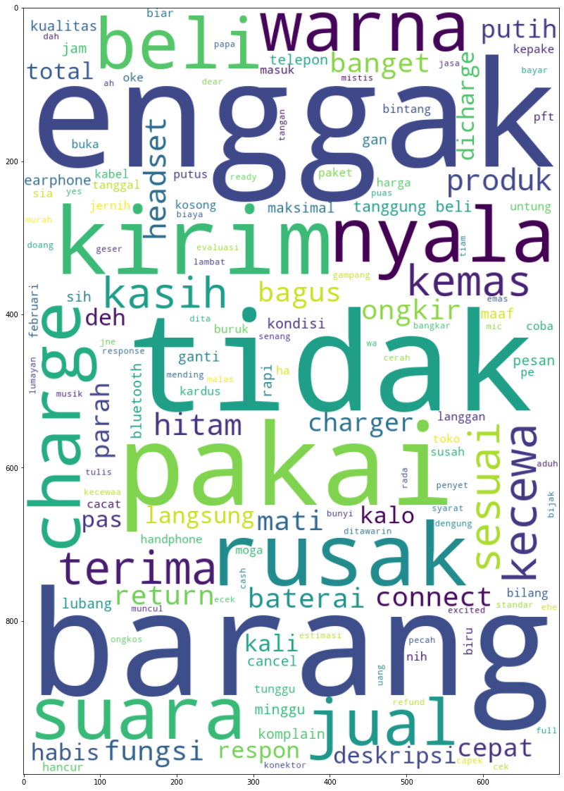
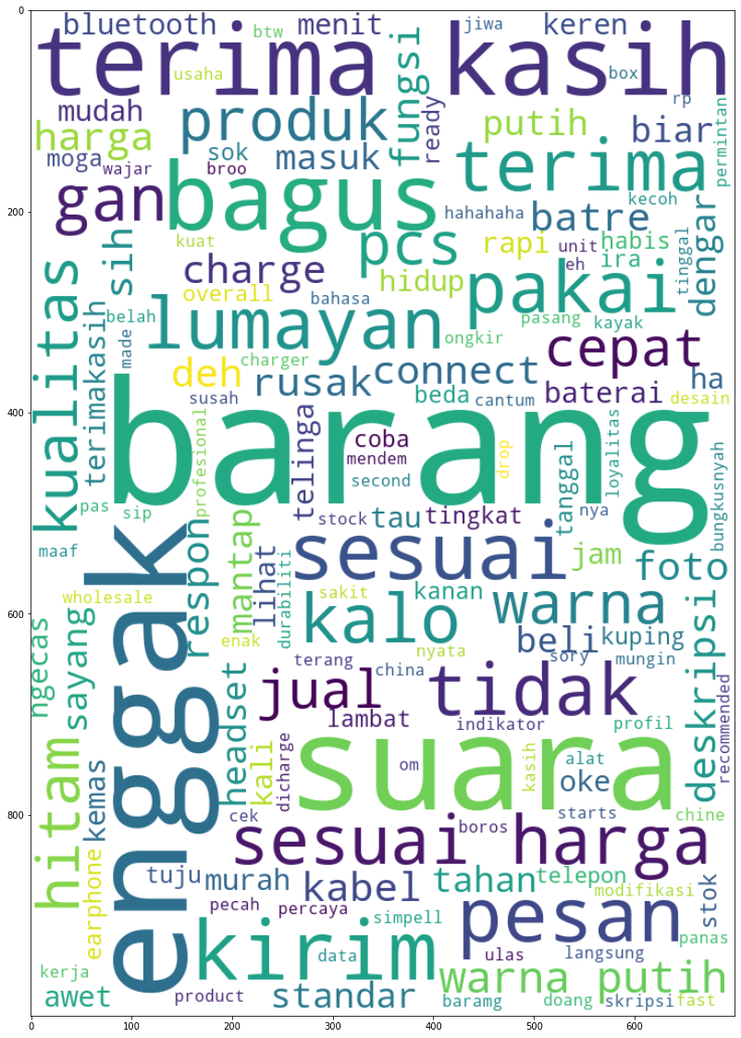
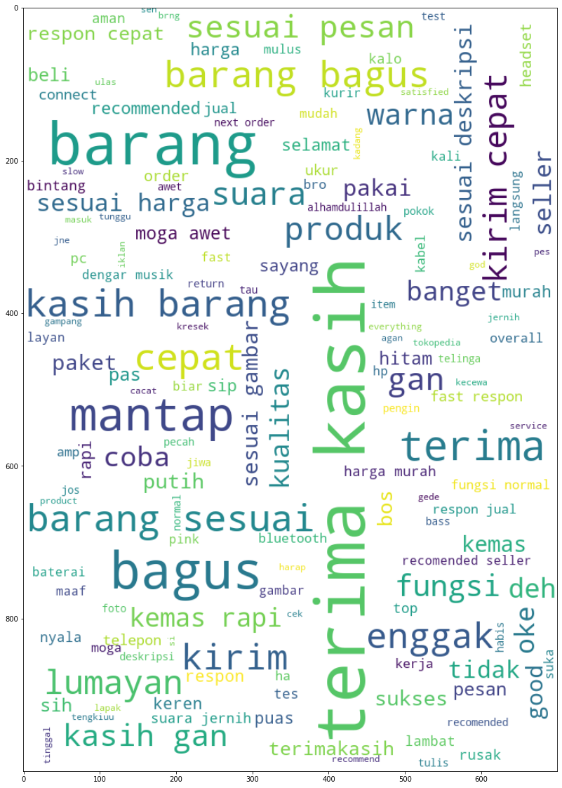
WORDCLOUD
Negative
Neutral
Positive
Text Summarization
Final Project FTDSH8#003

Slide 14
MODEL BUILDING
Text Summarization
Final Project FTDSH8#003
Extractive Pre-Trained BERTModel
Abstractive Pre-Trained Pegasus
Extractive TextRank Similarity

Slide 15
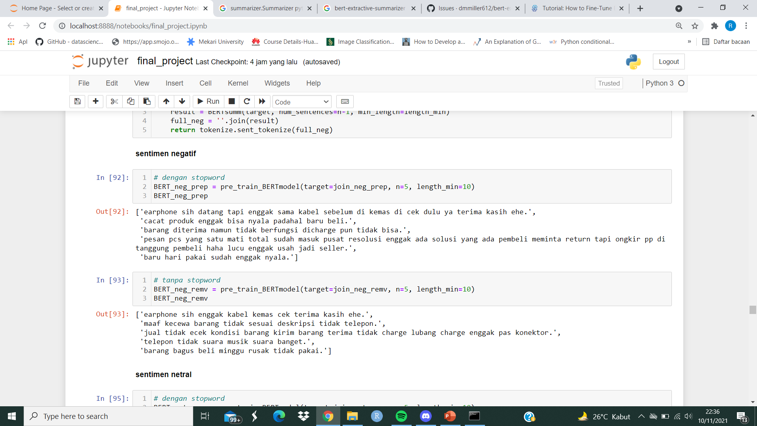
Extractive Pre-Trained BERTModel: Negative Sentiment
With Stopwords (Column Preprocess)
Without Stopwords (Column Removed Stopword)
Text Summarization
Final Project FTDSH8#003

Slide 16
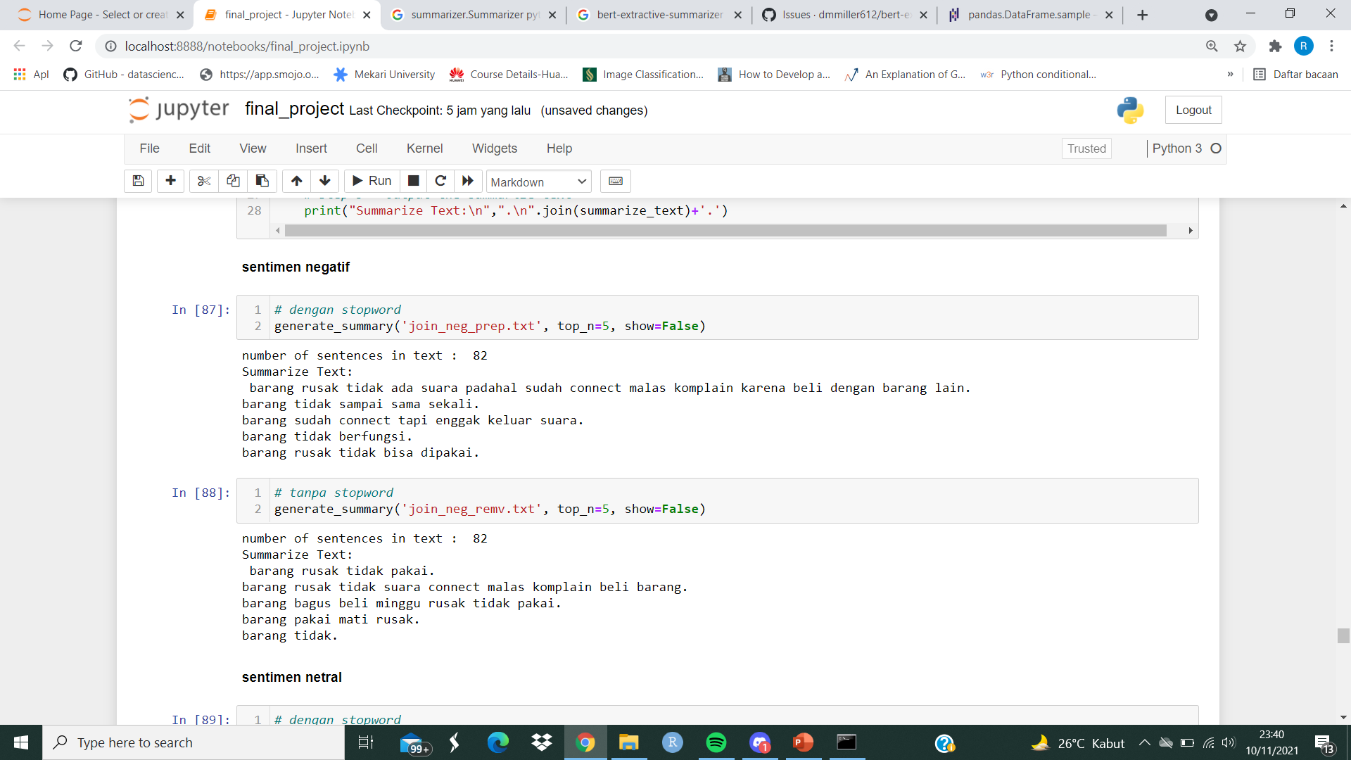
Extractive TextRank Similarity: Negative Sentiment
With Stopwords (Column Preprocess)
Without Stopwords (Column Removed Stopword)
Text Summarization
Final Project FTDSH8#003

Slide 17
MODEL INFERENCE
Text Summarization
Final Project FTDSH8#003

Slide 18
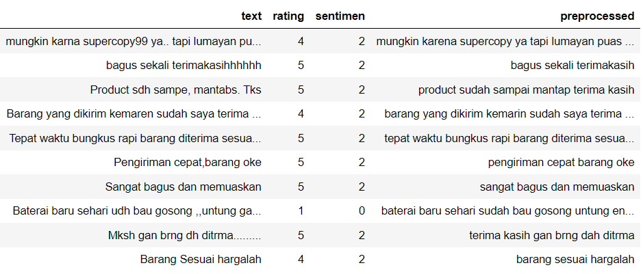
PREPROCESS
1. Data Input
2. Create Sentiments Label
3. Remove Unnecessary characters and
Word Transformation
Text Summarization
Final Project FTDSH8#003

Slide 19
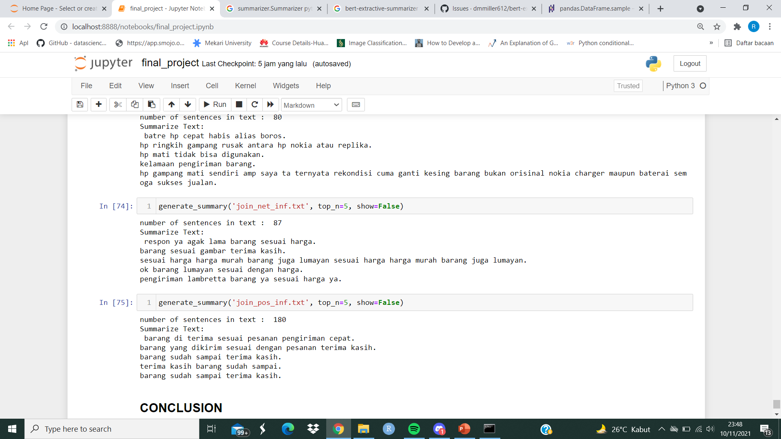
SUMMARIZATION
Negative
Neutral
Positive
Text Summarization
Final Project FTDSH8#003

Slide 20
CONCLUSION
Text Summarization
Final Project FTDSH8#003

Slide 21
CONCLUSION
Preprocessing done in this experiment: creating sentiments label, removing unnecessary characters, and transformize colloquial word to its formal/common word.
Extractive TextRank Similarity gave better consistency of result between sentece with and without Stopword compared to BERTmodel.
Text Summarization
Final Project FTDSH8#003

Slide 22
DISCUSSION
Text Summarization
Final Project FTDSH8#003

Slide 23
DISCUSSION
For inference, this experiment proposed input file in .csv format with 2 columns: text and rating.
This experiment is still lacking of Appropriate Evaluation Method to compare between model/algorithm performance for model selection.
TextRank Similarity algorithm has limitation on numbers of word variance. To prevent this, input data need to be resampled with estimated maximum 160 entries. Other method worth to try as: embedding mask based on word frequency.
Text Summarization
Final Project FTDSH8#003

Slide 24
DISCUSSION
Fine-Tuning BERTmodel and Pegasus need a whole lot of labelled data and strong computation power. But its interesting to see pre-trained model using Indonesian Language.
Text Summarization
Final Project FTDSH8#003

Slide 25
THANK YOU
Text Summarization
Final Project FTDSH8#003

Slide 26
EXTRA MATERIALS
Text Summarization
Final Project FTDSH8#003

Slide 27
MODEL BUILDING
Text Summarization
Final Project FTDSH8#003
Extractive Pre-Trained BERTModel
Abstractive Pre-Trained Pegasus
Extractive TextRank Similarity

Slide 28
Extractive Pre-Trained BERTModel: Negative Sentiment
With Stopwords (Column Preprocess)
Without Stopwords (Column Removed Stopword)
Text Summarization
Final Project FTDSH8#003

Slide 29
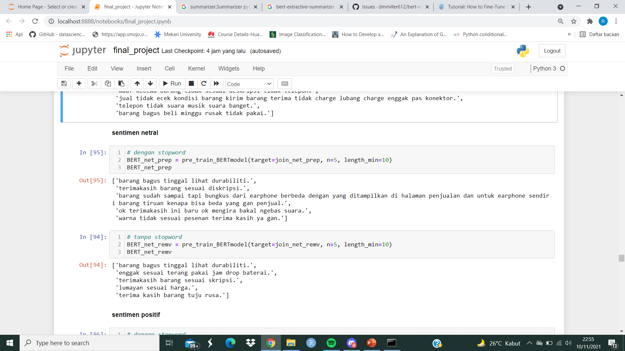
Extractive Pre-Trained BERTModel: Neutral Sentiment
With Stopwords (Column Preprocess)
Without Stopwords (Column Removed Stopword)
Text Summarization
Final Project FTDSH8#003

Slide 30
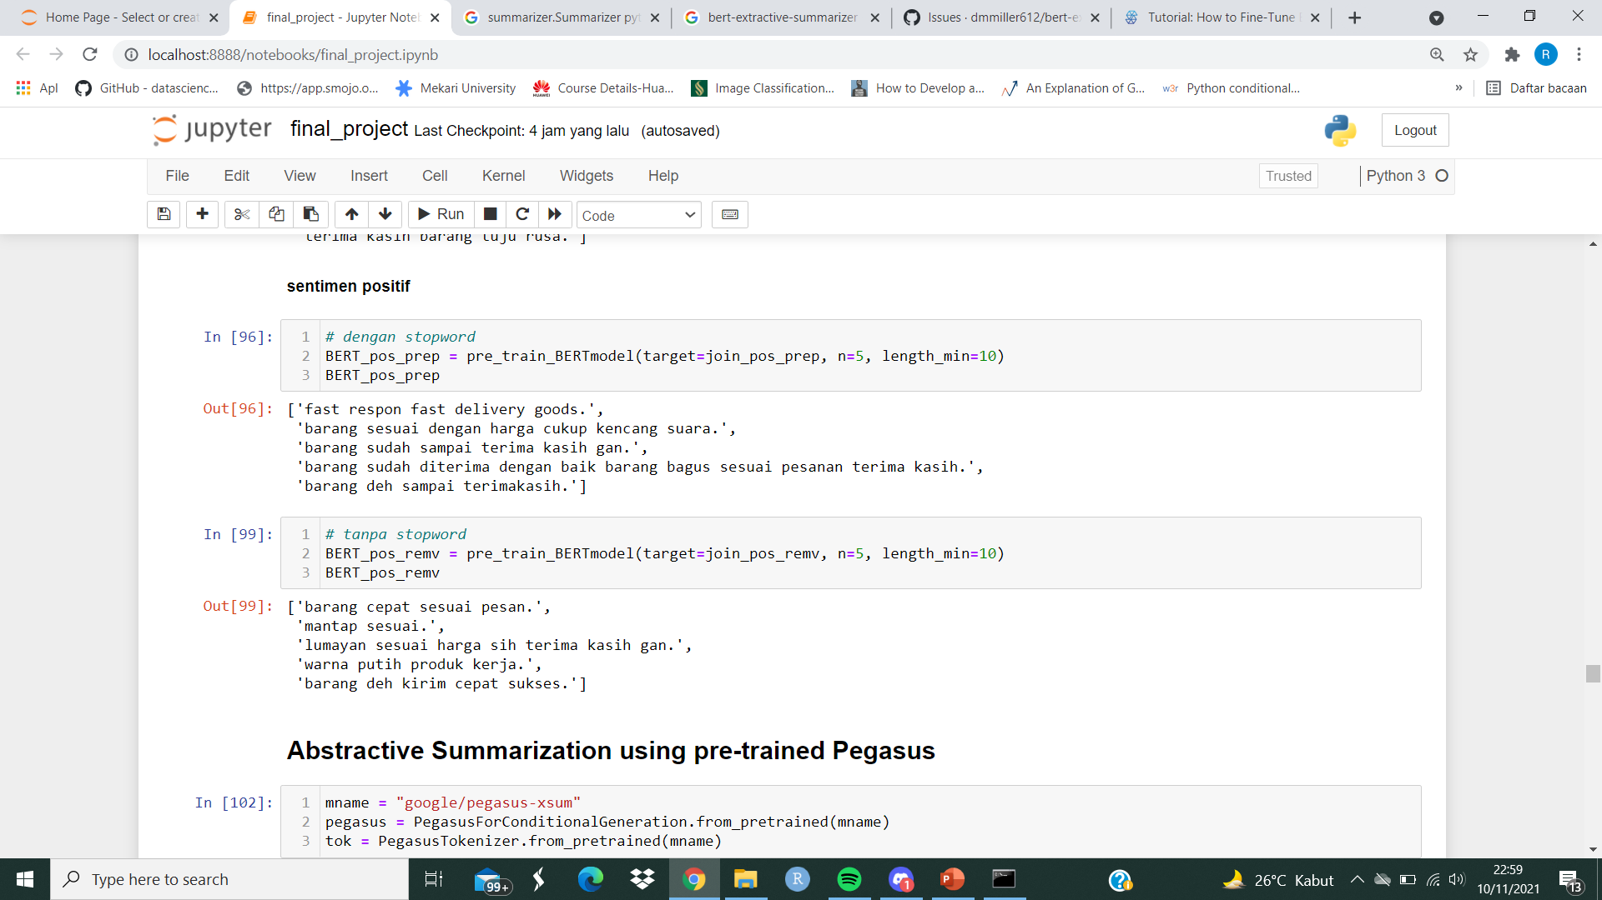
Extractive Pre-Trained BERTModel: Positive Sentiment
With Stopwords (Column Preprocess)
Without Stopwords (Column Removed Stopword)
Text Summarization
Final Project FTDSH8#003

Slide 31
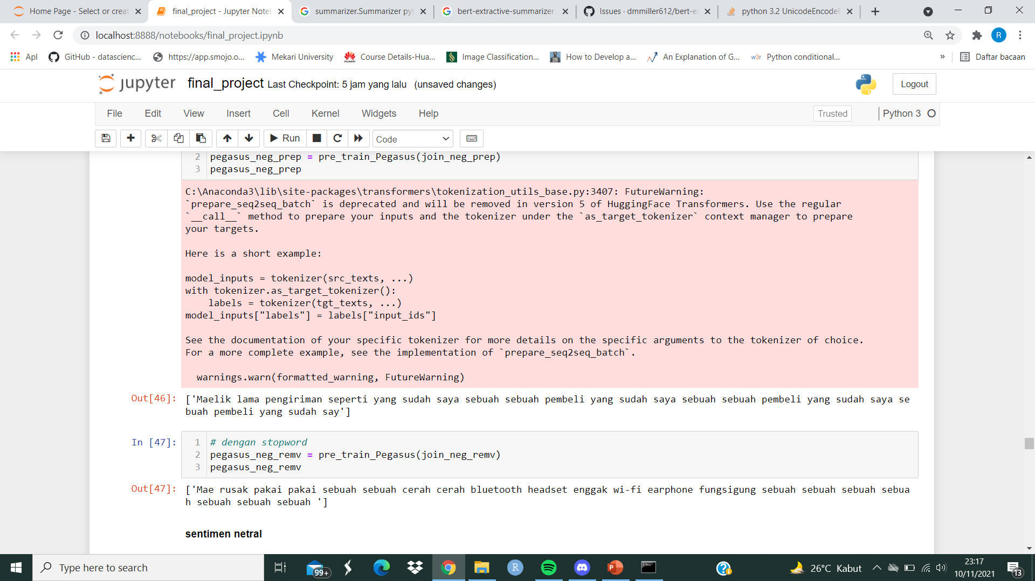
Abstractive Pre-Trained Pegasus: Negative Sentiment
With Stopwords (Column Preprocess)
Without Stopwords (Column Removed Stopword)
Text Summarization
Final Project FTDSH8#003

Slide 32
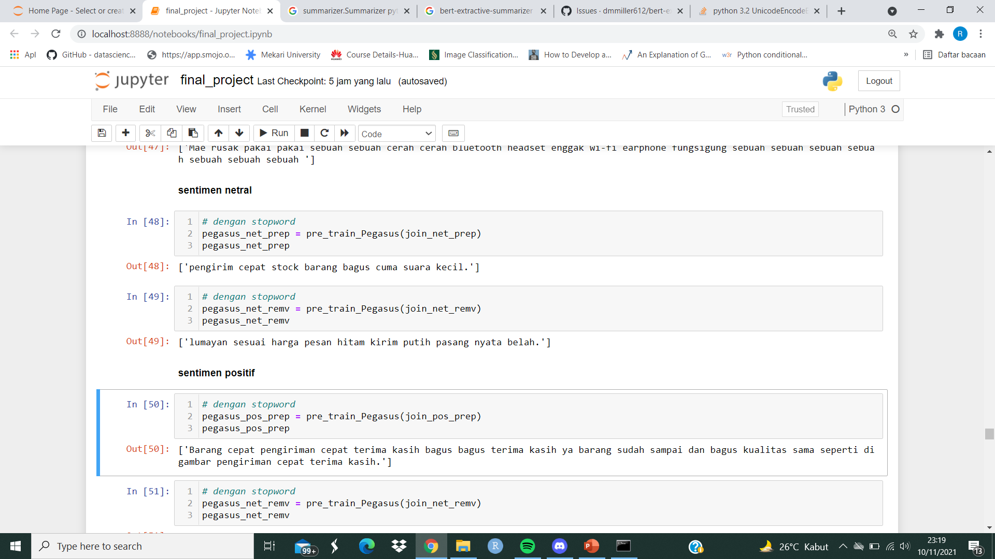
Abstractive Pre-Trained Pegasus: Neutral Sentiment
With Stopwords (Column Preprocess)
Without Stopwords (Column Removed Stopword)
Text Summarization
Final Project FTDSH8#003

Slide 33
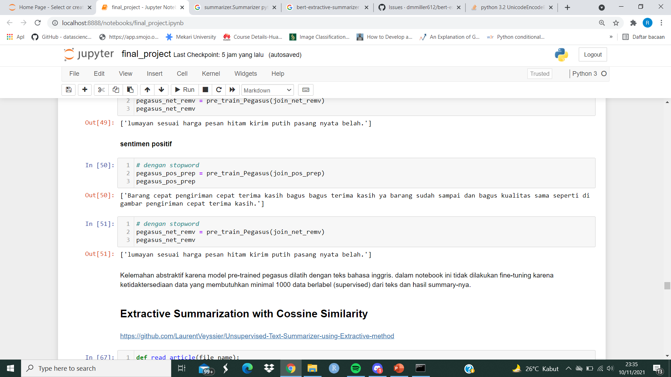
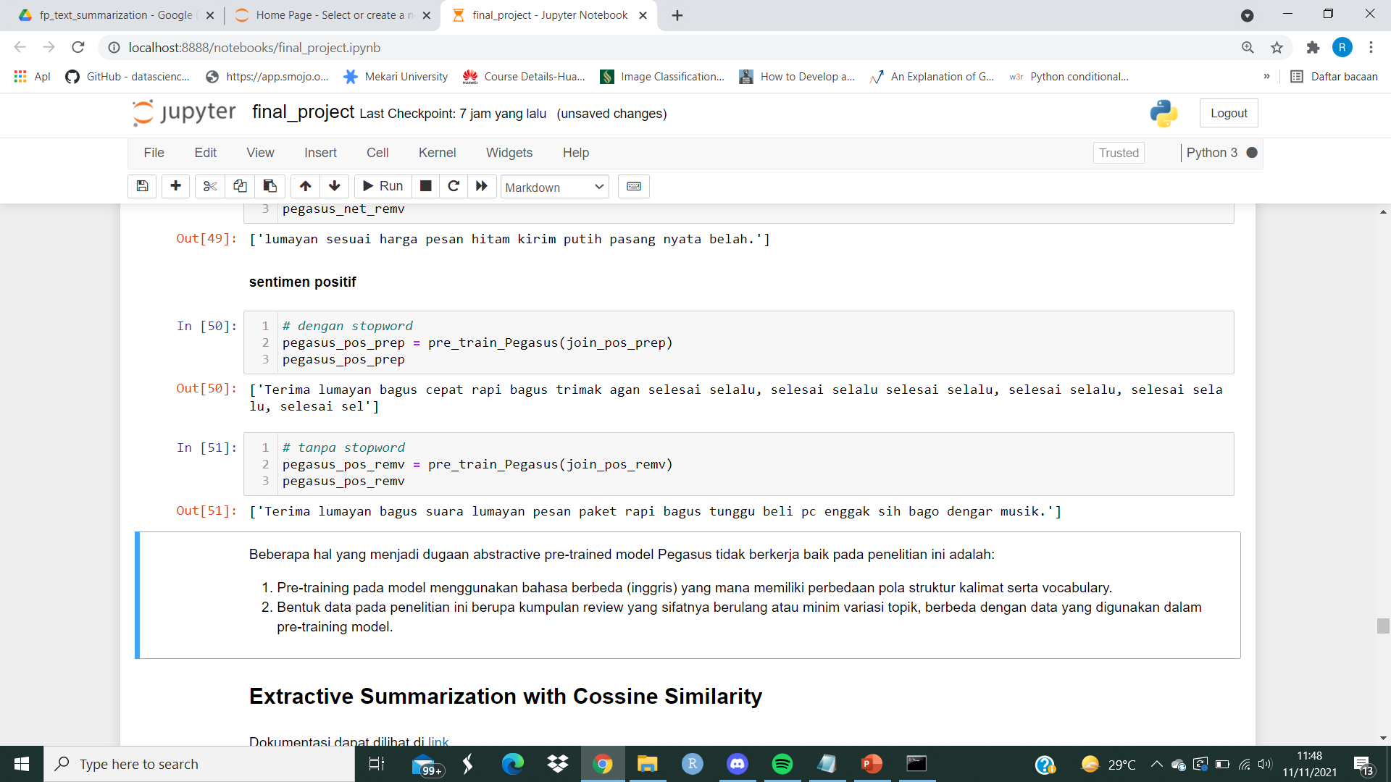
Abstractive Pre-Trained Pegasus: Positive Sentiment
With Stopwords (Column Preprocess)
Without Stopwords (Column Removed Stopword)
Text Summarization
Final Project FTDSH8#003

Slide 34
Extractive TextRank Similarity: Negative Sentiment
With Stopwords (Column Preprocess)
Without Stopwords (Column Removed Stopword)
Text Summarization
Final Project FTDSH8#003

Slide 35
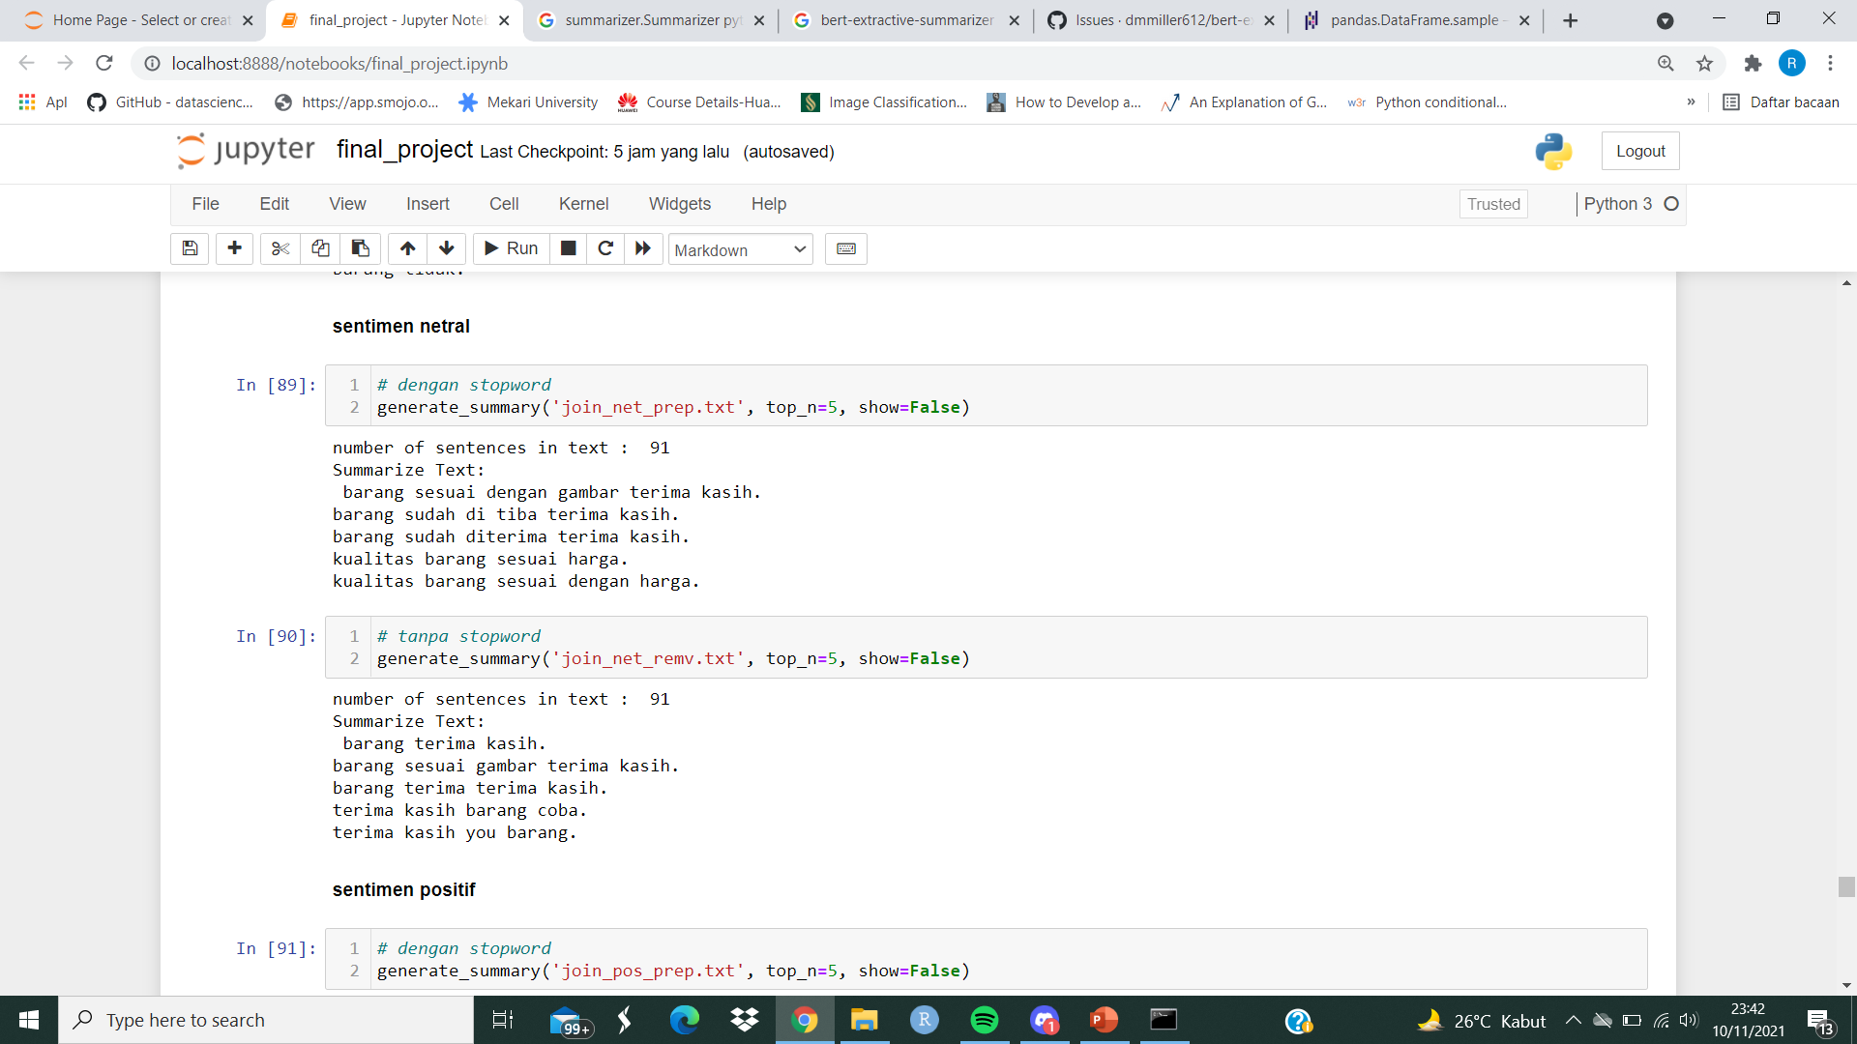
Extractive TextRank Similarity: Neutral Sentiment
With Stopwords (Column Preprocess)
Without Stopwords (Column Removed Stopword)
Text Summarization
Final Project FTDSH8#003

Slide 36
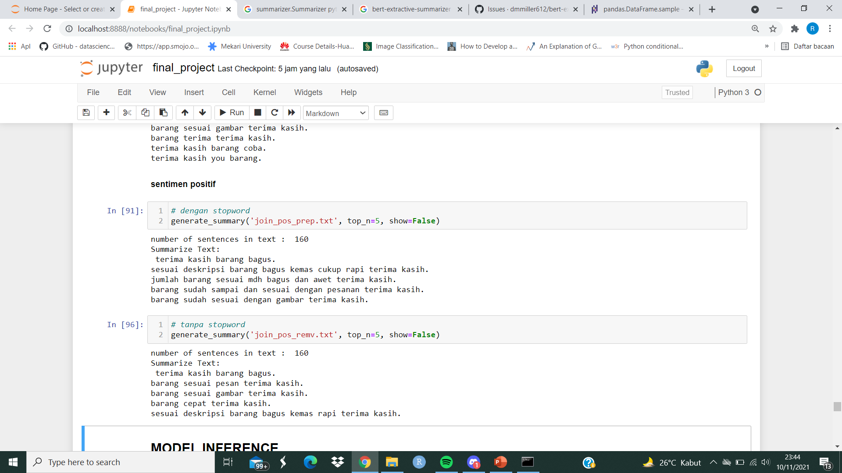
Extractive TextRank Similarity: Positive Sentiment
With Stopwords (Column Preprocess)
Without Stopwords (Column Removed Stopword)
Text Summarization
Final Project FTDSH8#003

